Slide 1
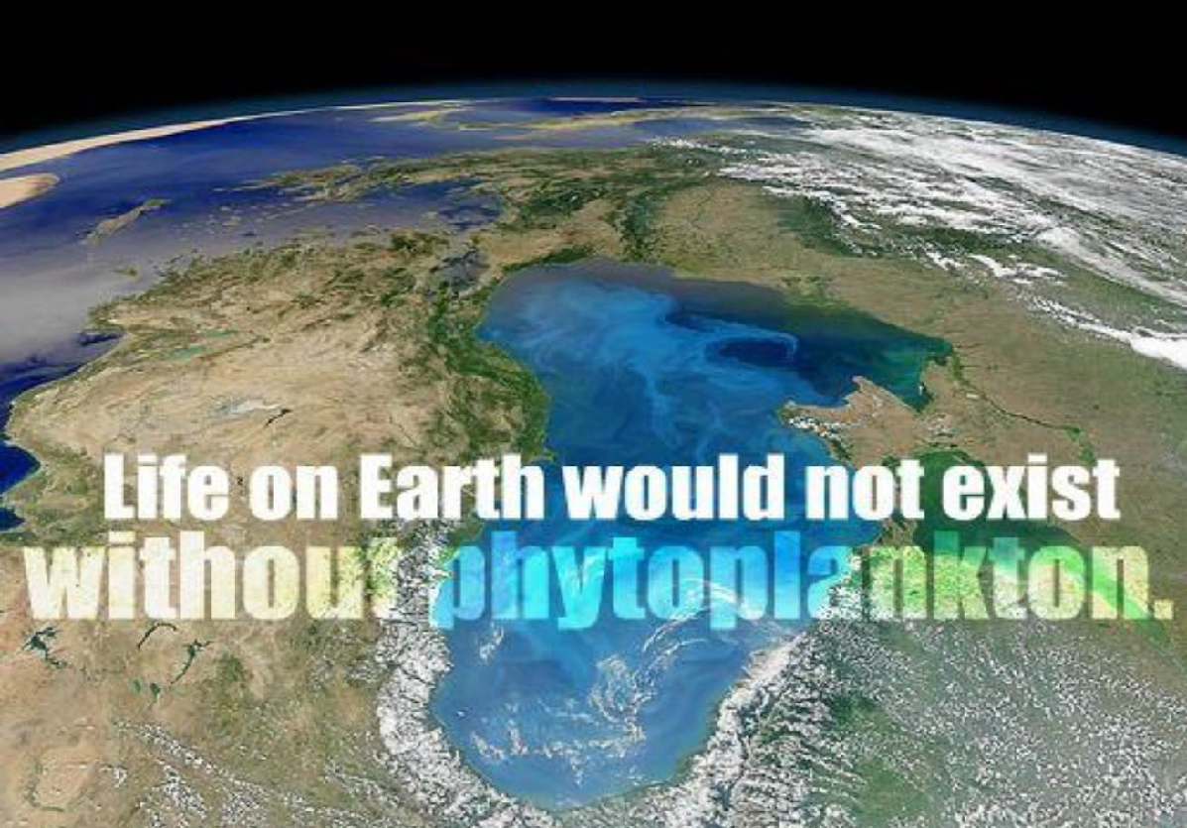

Slide 2
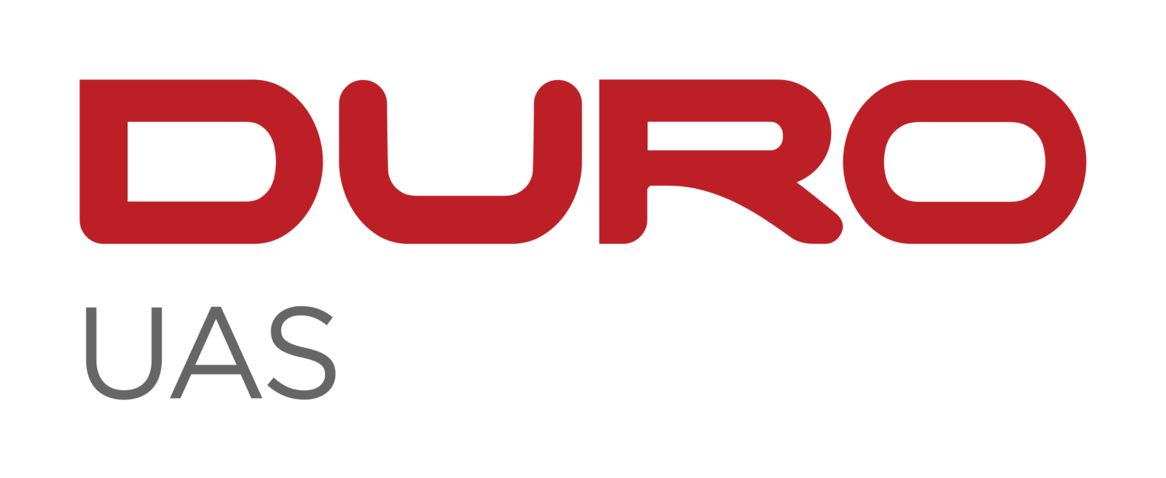
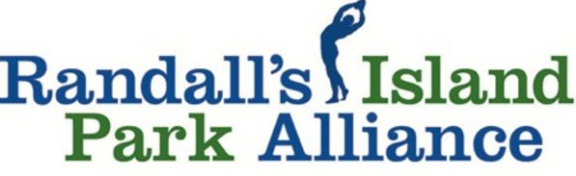
HARMFUL ALGAL BLOOMS (HABS) MONITORING: A CITIZEN SCIENCE APPROACH
Dr. Jennifer Cherrier, NOAA CESSRST, CUNY
Dr. Steven Morton, NOAA, NCCOS
Dr. Shakila Merchant, NOAA CESSRST, CUNY
Dr. Tarendra Lakhankar, NOAA CESSRST, CUNY
Ms. Nia Rene, NOAA NCCOS
Ms. Carolina Perez, CUNY CREST Institute
Mr. Christopher Girgenti, Randall's Island Park Alliance
Ms. Jacqueline Wu, Randall's Island Park Alliance
Mr. Tim Gilman-Ševčík, RETI Center
Ms. Jae Wendell, RETI Center
Mr. Brian Wilson, DURO UAS

Slide 3
NOAA’S NATIONAL OCEAN SERVICE’S MISSION
Harmful Algal Bloom Monitoring System
Harmful algal blooms (HABs), sometimes known as "red tide", occur when certain kinds of algae grow very quickly, forming patches, or "blooms", in the water.
These blooms can emit powerful toxins which endanger human and animal health.
Reported in every coastal state, HABs have caused an estimated $1 billion in losses over the last several decades to coastal economies that rely on recreation, tourism, and seafood harvesting.
Blooms can lead to odors that require more costly treatment for public water supplies.
NCCOS conducts and funds research that helps communities protect the public and combat blooms in cost-effective ways, and we are breaking new ground in the science of stopping blooms before they occur

Slide 4
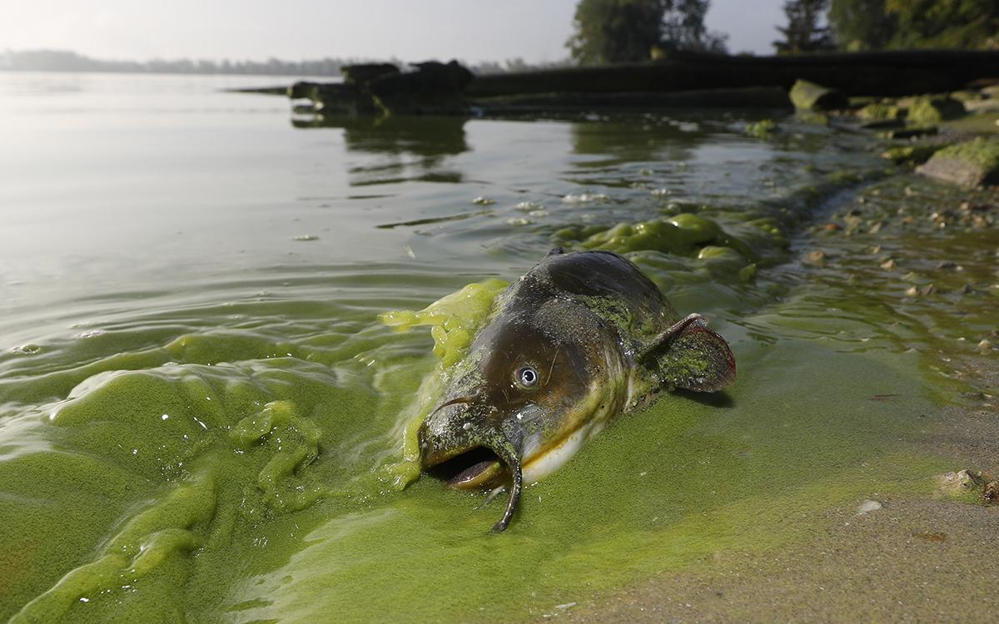
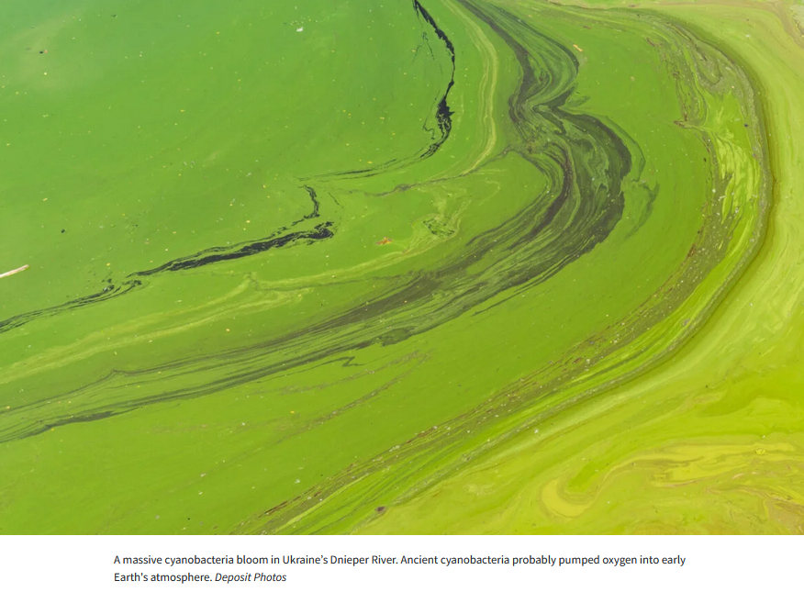
CLIMATE CHANGE || GLOBAL WARMING || ALGAL BLOOMS
HABs and Climate Change
Algae-filled waters of North Toledo, Ohio, in September 2017 | Photo by Andy Morrison/The Blade via AP Photo

Slide 5
CLIMATE CHANGE || GLOBAL WARMING || ALGAL BLOOMS
Warming Lakes Worldwide Could Mean More Toxic Algal Blooms
A first-ever global survey of lakes links climate change to increased blooms
In August 2018, Florida governor Rick Scott declared a state of emergency after a crimson “red tide” of toxic algae flooded the waters of the Gulf, overwhelming popular beaches, shutting down tourism, and making it difficult for coastal residents to breathe.
The blooms were linked in part to a US Army Corps of Engineers decision to release huge amounts of nutrient-laden water from Lake Okeechobee after Hurricane Irma dumped record rainfall in the area.
Toxic algae is killing Florida's sea life
CNN’s Bill Weir visits the gulf coast of Florida where an algae bloom known as a red tide has killed thousands of marine animals.

Slide 6
FLORIDA ALGAL BLOOMS IMPACTS MARINE LIFE
3 years ago, a massive algae bloom in Florida killed 2,000 tons of marine life.
It's threatening again.
By Arthur Brice, CNN (2021)

Slide 7
LAKE ERIE ALGAE BLOOMS
POLLUTING OUR DRINKING WATER
Lake Erie’s algae blooms are an annual threat to the health and drinking water of more than 11 million people.
This is unacceptable.

Slide 8
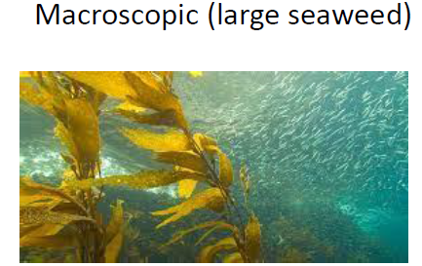
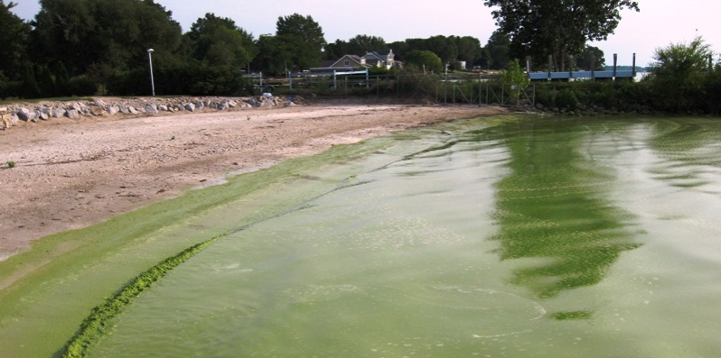
PLANKTONS TO BLOOMS
Harmful Algal Blooms

Slide 9
ALGAL BLOOMS – WHY THEY ARE CRITICAL

Slide 11
WATER SAMPLING SITES – NEW YORK CITY

Slide 12
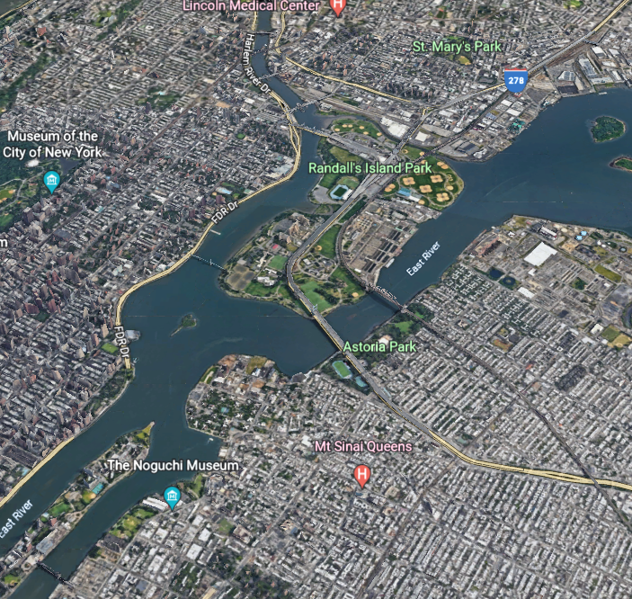
PROPOSED SITES
In your Community?
In your neighborhood?
Randall’s Island
Gowanus Canal
Red Hook Farm
East River?
Center Park??
Prospect Park???
Jamaica Bay????

Slide 13
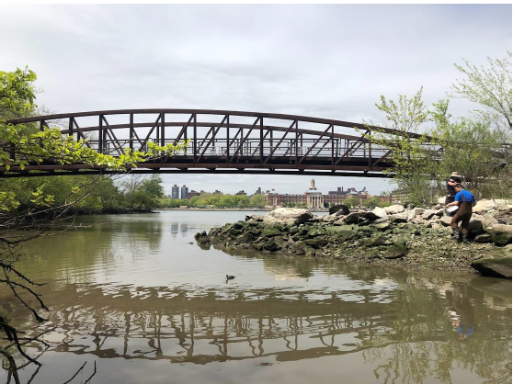
PROPOSED SITES : RANDALL’S ISLAND PARK ALLIANCE

Slide 14
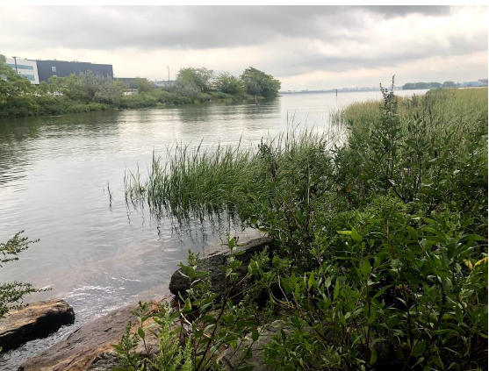
PROPOSED SITES : RANDALL’S ISLAND PARK ALLIANCE

Slide 15
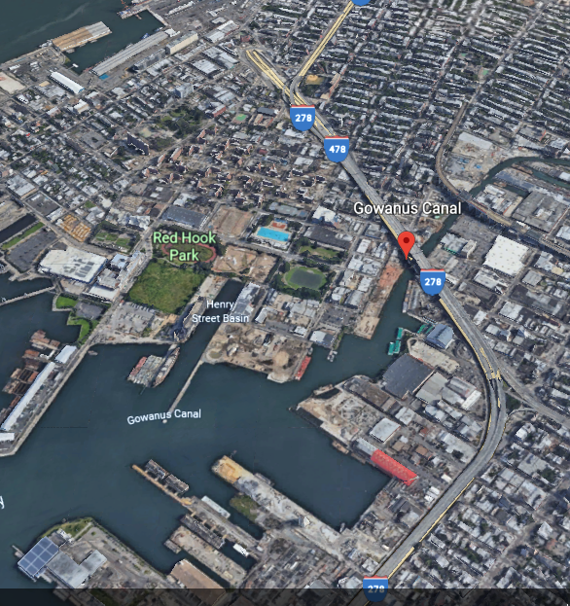
PROPOSED SITE : GOWANUS CANAL /RED HOOK

Slide 16
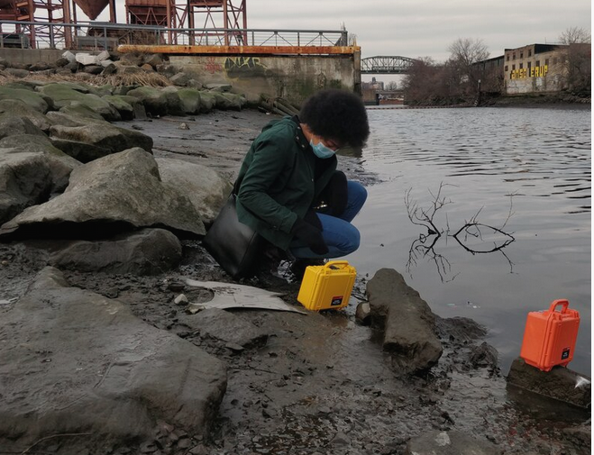
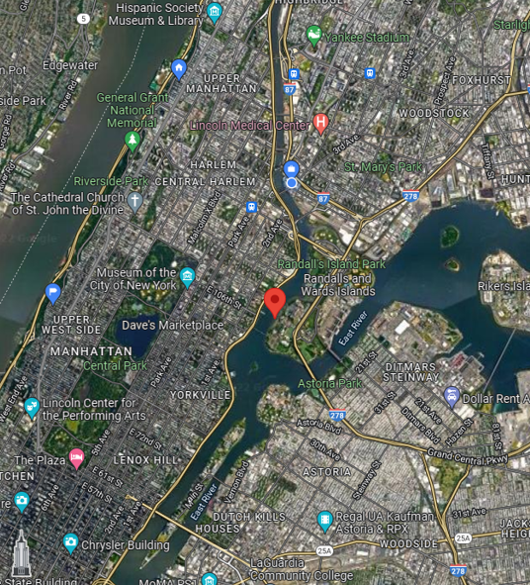
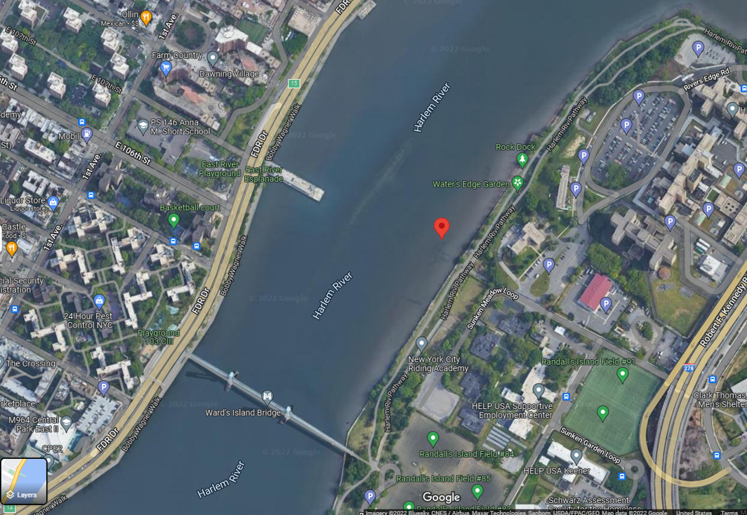
PHYSICAL WATER QUALITY STUDY SITE – DURO SONDE

Slide 17
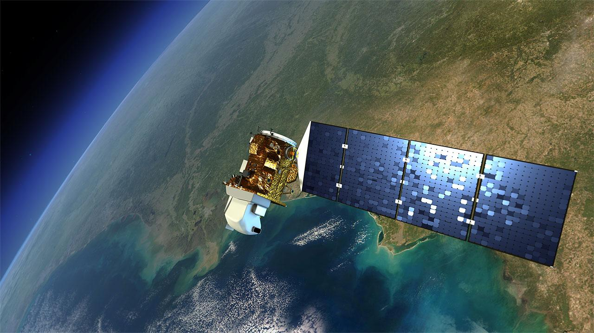
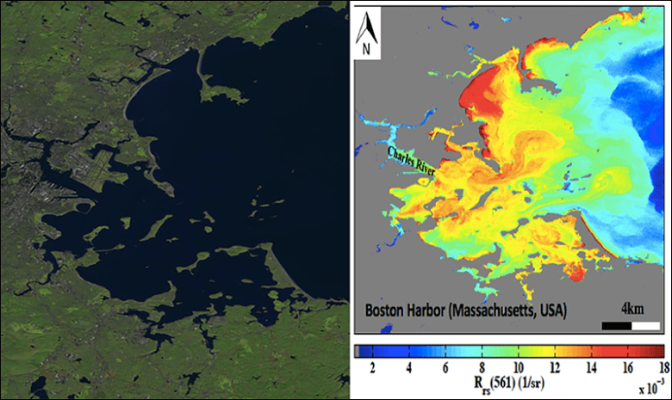
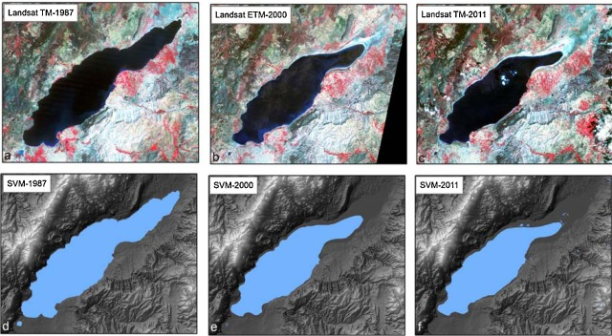
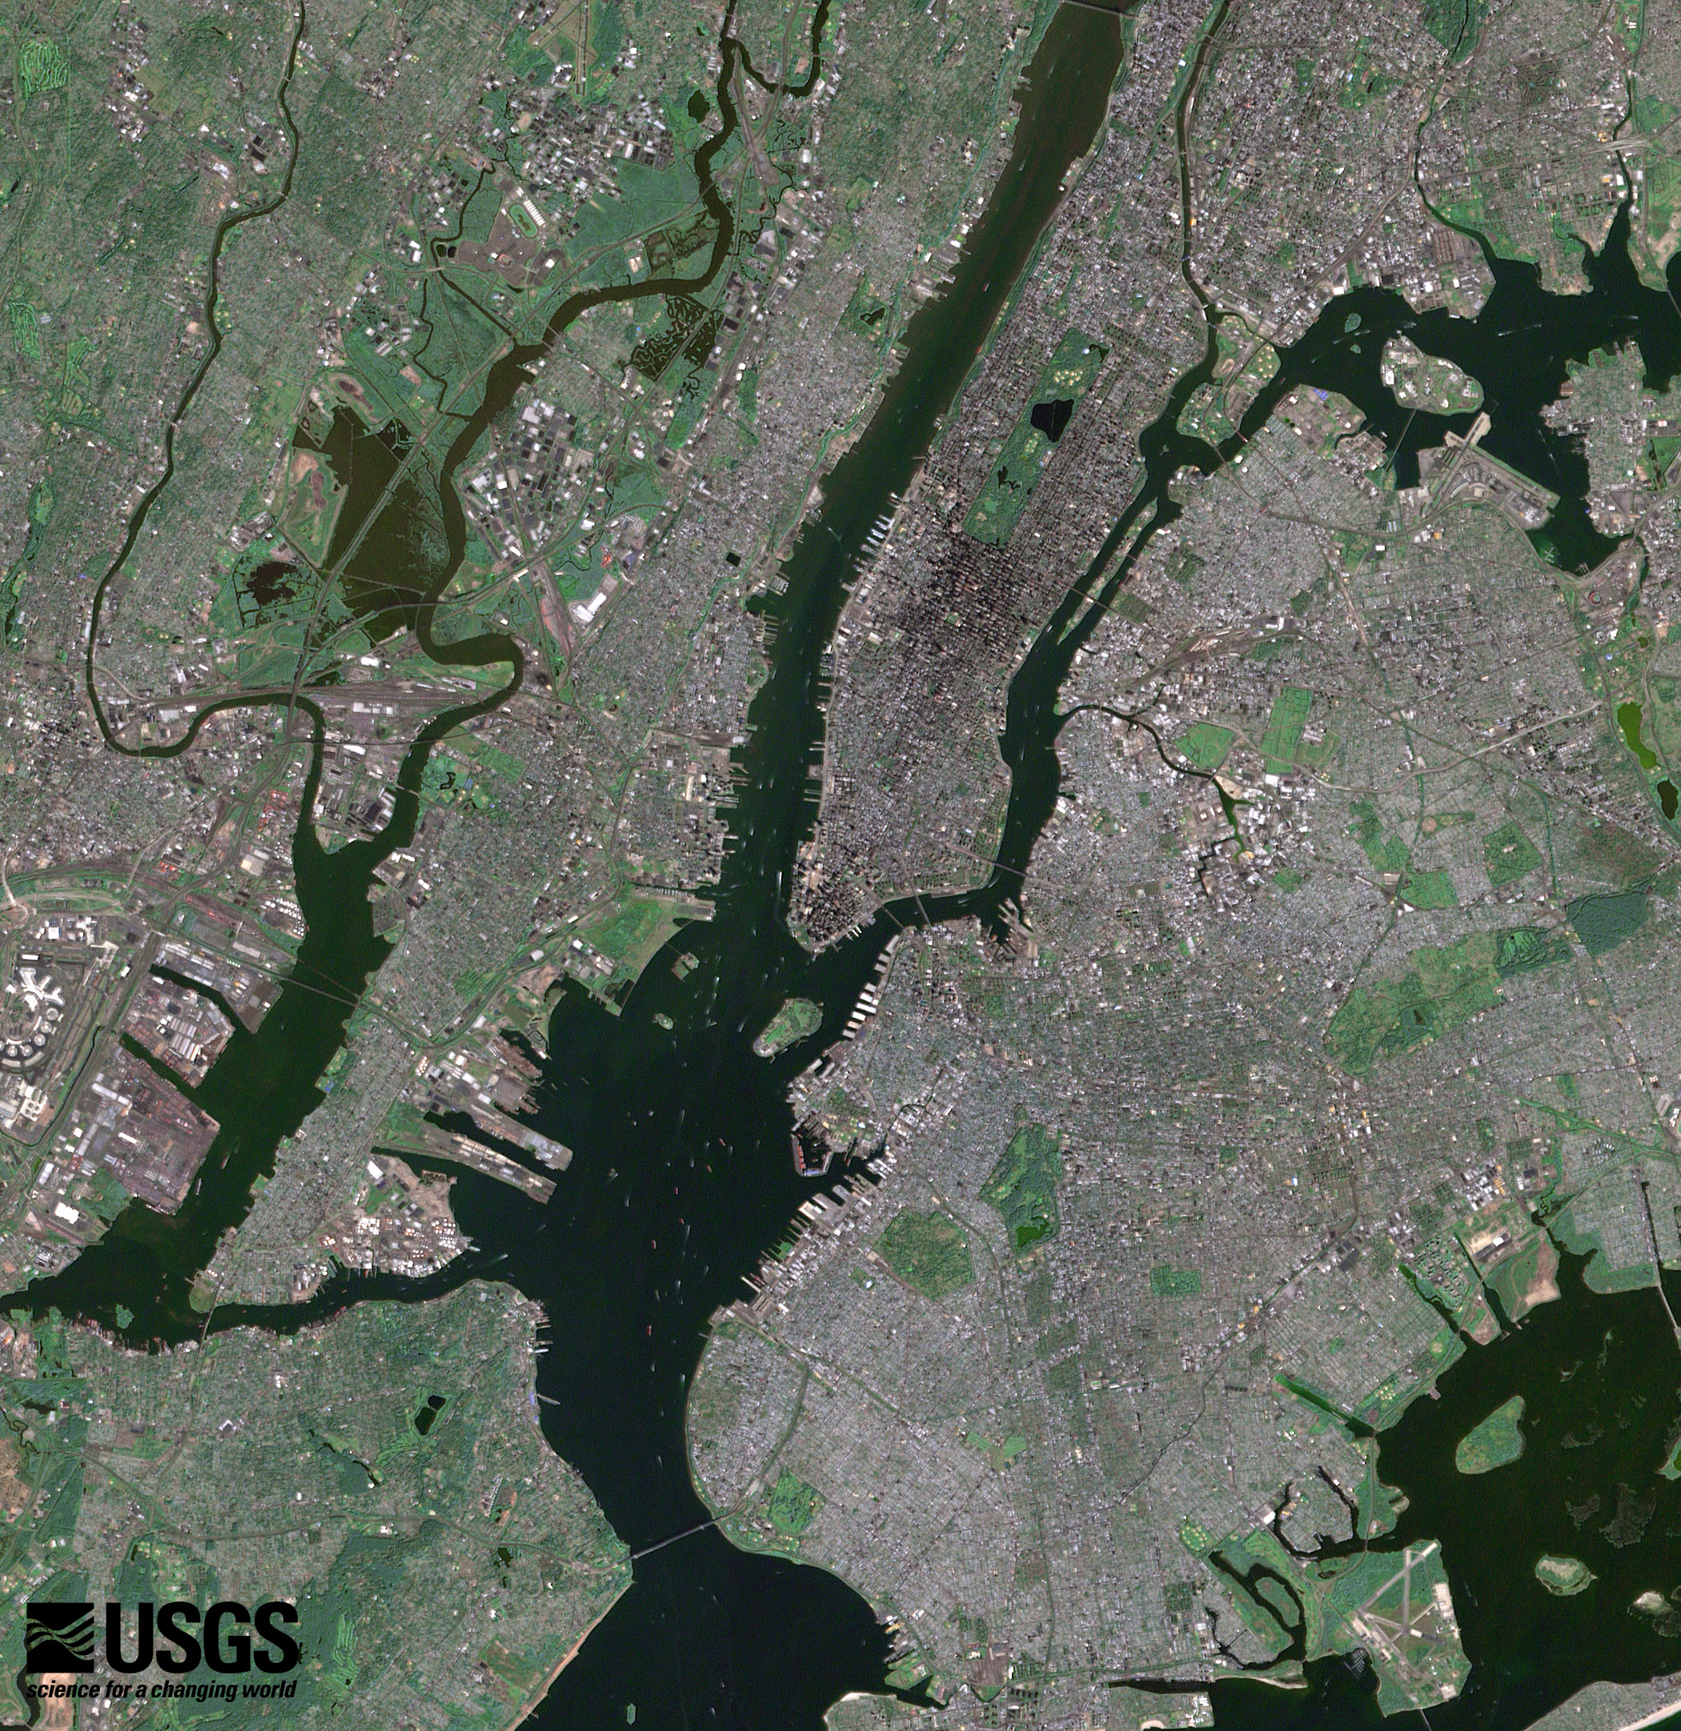
WATER QUALITY STUDY USING LANDSAT DATA
The Landsat program is the longest-running (from 1972) enterprise for acquisition of satellite imagery of Earth lead by NASA and USGS.
The most recent, Landsat 9, was launched on 27 September 2021.
The Landsat images can be used for water quality and quantity analysis
Water Quality Estimation
Water Quantity Estimation

Slide 18
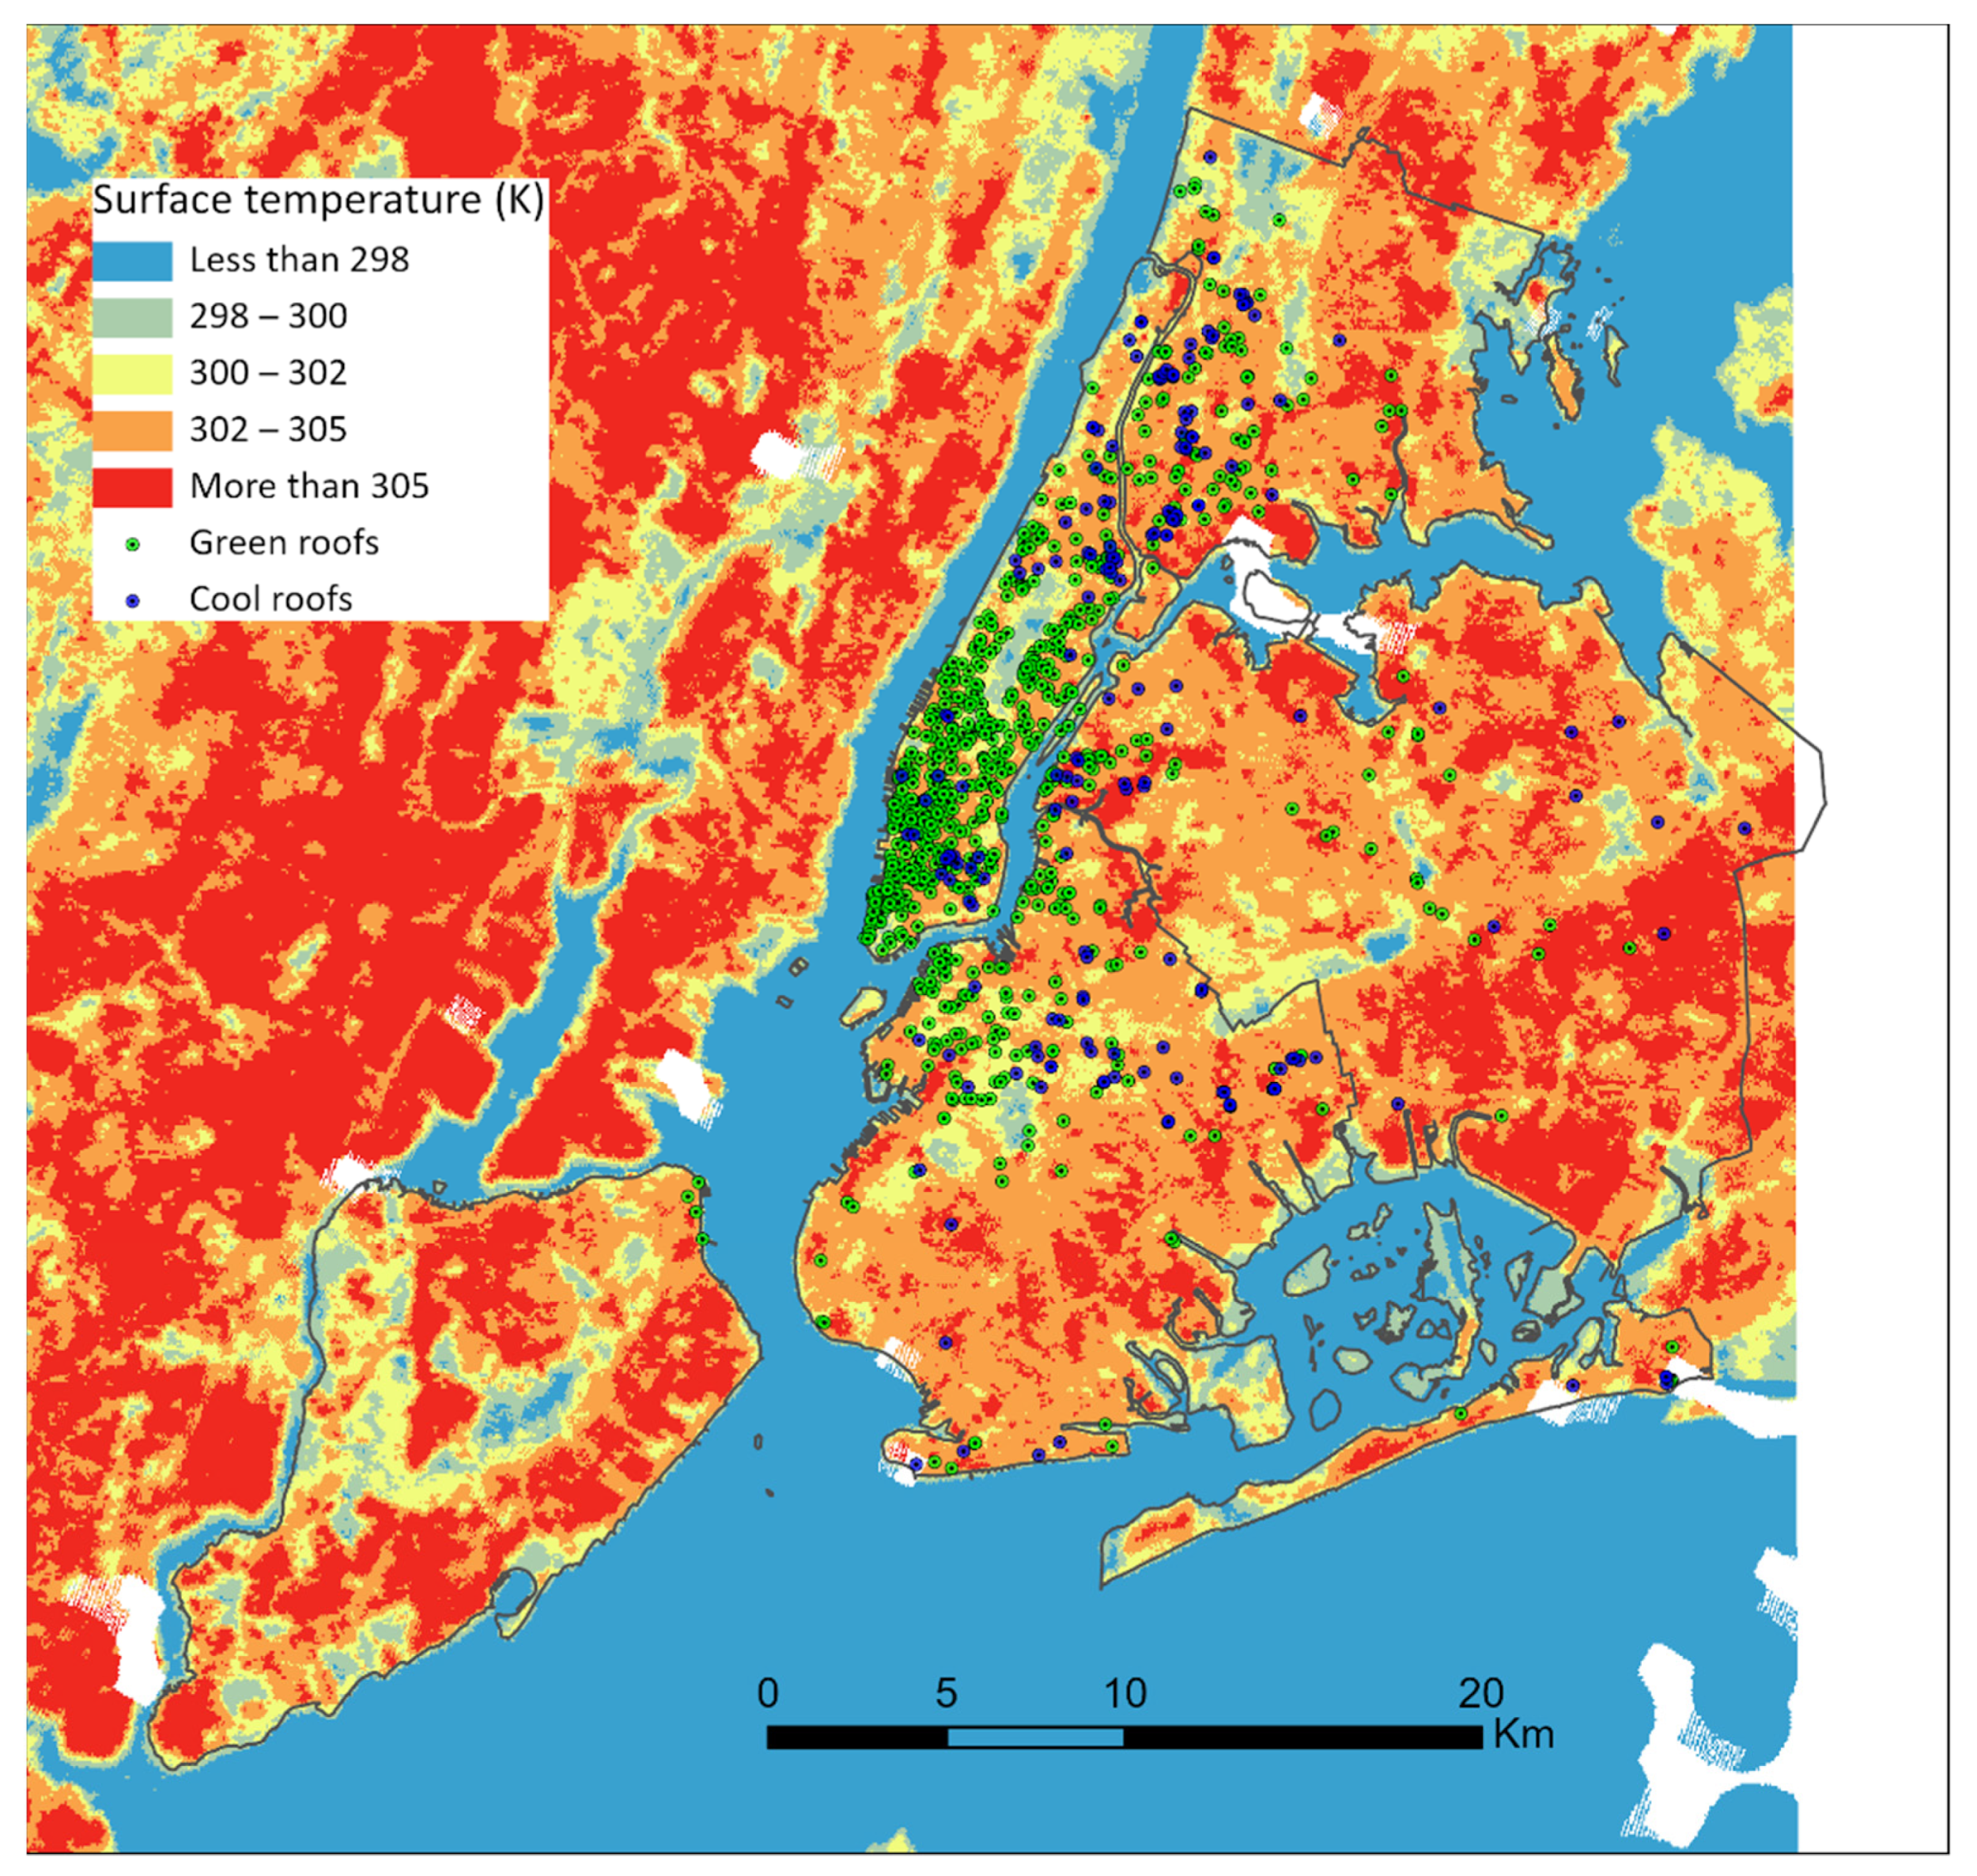
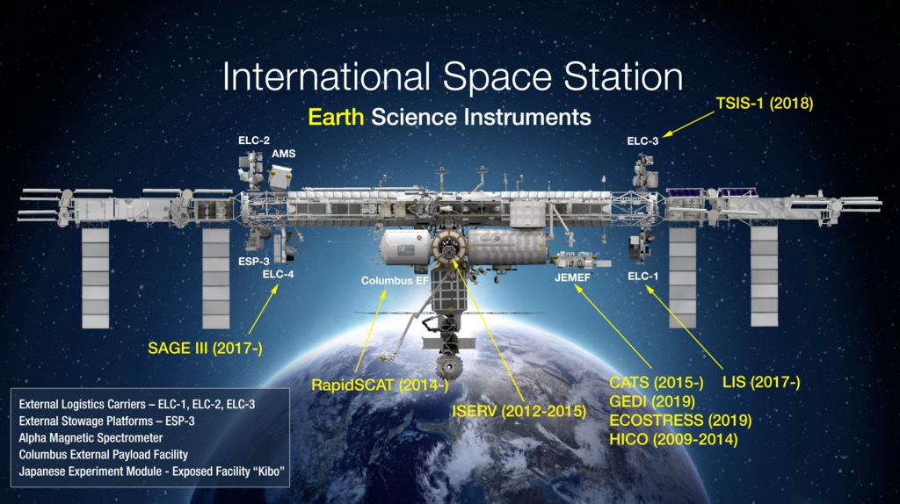
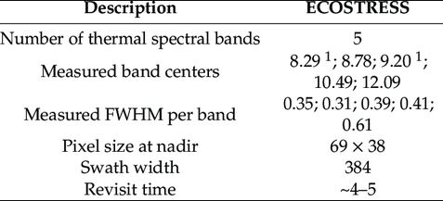
ECOSTRESS AND WATER QUALITY
The ECOsystem Spaceborne Thermal Radiometer Experiment on Space Station (ECOSTRESS) launched on June 29, 2018.
Monitor one of the most basic processes in living plants: the loss of water through the tiny pores in leaves.
Maps showing surface temperature (K) measured by ECOSTRESS at 70 m spatial resolution on 27 August 2020. The building locations with cool roofs in 2012 and green roofs in 2016 in New York City.

Slide 19
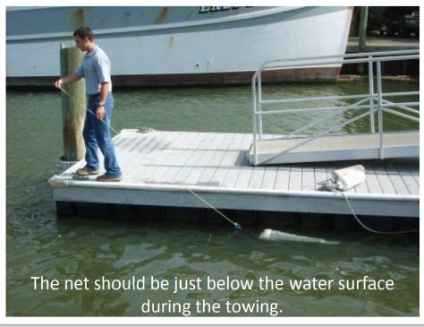
BIOLOGICAL PROPERTY : USING PLANKTON NET

Slide 20
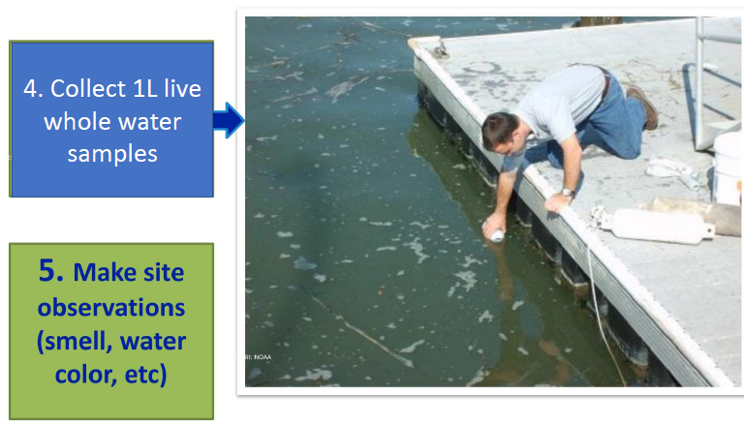
IN-SITU SAMPLING AND DATA COLLECTION PROTOCOL

Slide 21
LABORATORY ANALYSIS

Slide 22
U.S. NATIONAL OFFICE FOR HARMFUL ALGAL BLOOMS THE NATIONAL PHYTOPLANKTON MONITORING NETWORK (PMN) IS A COMMUNITY-BASED NETWORK OF VOLUNTEERS MONITORING MARINE PHYTOPLANKTON AND HABS.

Slide 23
KEY OUTCOMES
Water Sampling and Data Analysis Skills
Hands-on Laboratory skills
Application of Satellite Data and GIS skills
Better Understanding of HABs and Impact on our Water Systems and Communities
Advocacy on HABs impact on Humans, Marine Life and Society
Citizen Science Approach to Early Monitoring and Prevention of HABs Occurrence
Stakeholder Engagement, Environmental Literacy

